Slide 1
MIDDLETON CHENEY
FOOTBALL CLUB

Slide 2
FIRST TEAM
1949-50
SEASON
OXFORD JUNIOR LEAGUE
AND CUPS

Slide 3
April 29th 1950
Buckingham Charity Cup Final Played at Buckingham
Buckingham 5 v 2 Middleton
H. Gibbard
R. Christie Goal Scorer H. Gibbard (Pen)
R. Christie
Ref

Slide 4
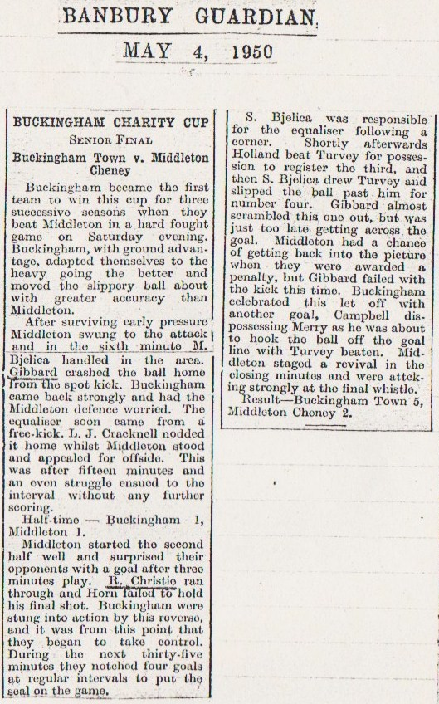

Slide 5
May 6th 1950
Brackley (Myers) Charity Cup Final Played at Brackley
Easington Sports 2 v 4 Middleton
T. McMahon
B. Tustain Goal Scorer T. McMahon
L. Fortnum B. Tustain 2
L. Fortnum
Ref

Slide 6
